Slide 1
Use PyTorch to build neural networks

Slide 2
Key Concepts in PyTorch
Tensors: Multi-dimensional arrays that are the fundamental building blocks in PyTorch.
Autograd: Automatic differentiation system for computing gradients (that powers neural network training).
NN Module: The core building block for creating neural networks.
Optimizers: Algorithms for adjusting the parameters of the network to minimize loss.
PyTorch is an open-source deep learning framework.
Allow flexible, dynamic computation graph, and ease of use.
PyTorch is widely used in both academia and industry for research and production.
Integration with Python: PyTorch operates more like a Python library than a framework.

Slide 3

How to Install PyTorch in Anaconda with Conda or Pip
Open the Anaconda Prompt or Terminal.
Create a new conda environment for PyTorch:
conda create --name pytorch_env
3. Activate the new environment:
conda activate pytorch_env
4. Install PyTorch:
conda install pytorch torchvision torchaudio -c pytorch
pip install torch torchvision torchaudio
5. Open Python IDE to Verify the installation:
import torch
print(torch.__version__)

Slide 4
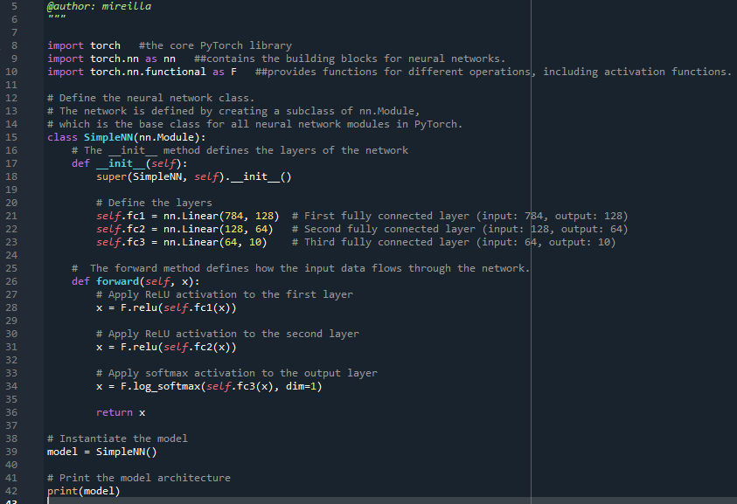
Example: Building a Simple Neural Network
Define a simple neural network with PyTorch's nn.Module.
Example: A fully connected network for a classification task.
e.g.:
self.fc1 = nn.Linear(784, 128) # 784 input features to 128 neurons

Slide 5
Popular activation functions in PyTorch
Logistic (or sigmoid) is a non-linear activation function.
Useful for binary classification tasks. It takes any input and maps it to a value between 0 and 1, making it useful for probability predictions.
Tanh is a non-linear activation function that outputs values between -1 and 1, with a mean output of 0.
Ensure that the output of a neural network layer remains centered around 0, making it useful for normalization; can be computationally expensive
ReLU (Rectified Linear Unit) is a non-linear activation function that outputs the input value if it is positive, or 0 if it is negative. computationally more efficient, well-suited for large-scale neural networks.
Linear is a module provided by PyTorch that applies a linear transformation to the incoming data.
Non-linear activation functions allow neural networks to capture complex patterns in data, which is essential for tasks like image recognition, natural language processing, and other AI applications.

Slide 6
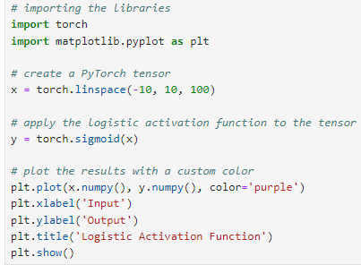
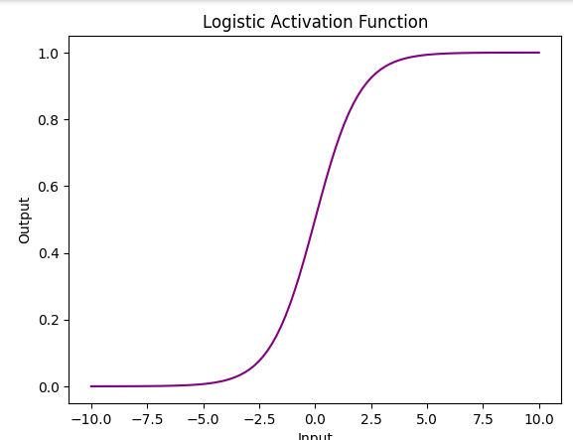
Logistic (or sigmoid) example
!pip install matplotlib on Jupyter Notebook will install it on Anaconda.
-10: This is the start value of the tensor. The first element in the tensor x will be -10.
10: This is the end value of the tensor. The last element in the tensor x will be 10.
100: This specifies the number of equally spaced values between -10 and 10. The tensor x will contain 100 elements.

Slide 7
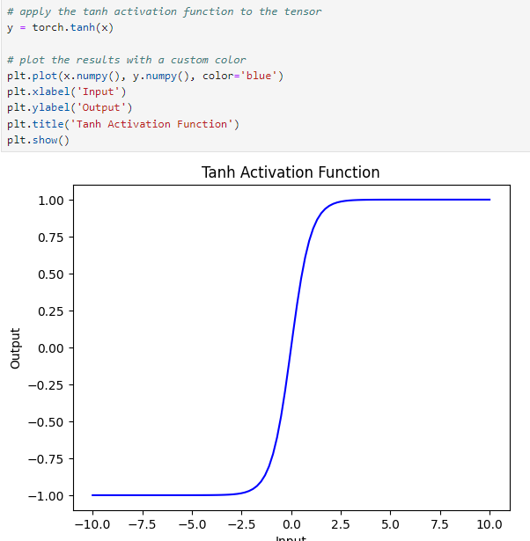
Tanh Activation Function example

Slide 8
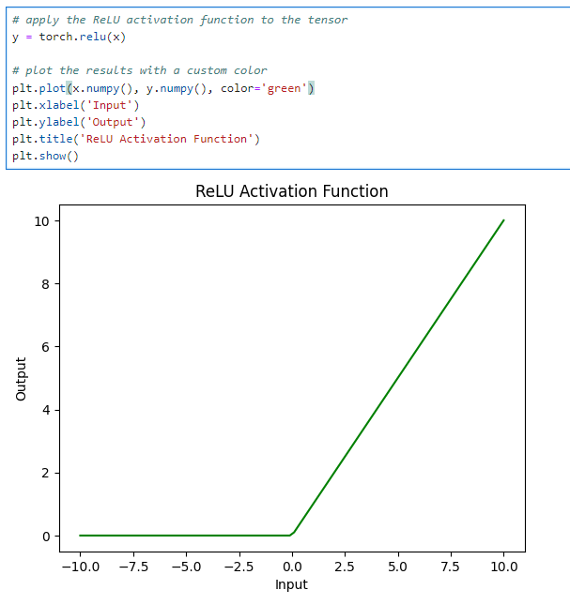
ReLU Activation Function

Slide 9
Neural Network Training Process
Phase 1 - Define the loss function measures how well the neural network’s predictions match the actual target values. It quantifies the error in the predictions, which the training process aims to minimise.
Common loss function: Cross-Entropy Loss used for classification tasks. Mean Squared Error (MSE) used for regression tasks.
Phase 2 - Select an optimizer. The optimizer updates the neural network's weights based on the gradients of the loss function with respect to the weights. The goal is to minimize the loss function by iteratively adjusting the weights.
Common optimizers: Stochastic Gradient Descent; Adam (Adaptive Moment Estimation)).

Slide 10
Neural Network Training Process
Phase 3 - Implement the training loop: Core process where the neural network learns from data. It involves feeding input data through the network, calculating the loss, and adjusting the weights to minimize the loss.
The steps are:
forward pass: Pass the input data through the network to obtain predictions. outputs = model(inputs)
Compute loss: Calculate the loss using the loss function. loss = criterion(outputs, targets)
backpropagation: Compute the gradients of the loss with respect to the model's parameters. loss.backward()
Update Weights: Use the optimizer to update the weights based on the computed gradients. optimizer.step()

Slide 11
Summary
Conda
Google Colab
PyTorch

